Slide 1

June 8/20 Original at 38.1 MB. When Neil downsized it slide effects were lost.

Slide 2


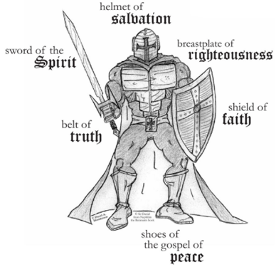
Let us put on the full Armor of Yahuah
Taking up the shield of faith with which you will be able to extinguish all the flaming arrows of the evil one.
Eph 6:16
Eph 6:10-20; 1 Thess 5:8; 2 Cor 6:7;
Heb 4:12; Isa 59:17; Isa 11:5;
2 Cor 10:3-5; Rom 13:14; Prov 30:5

Slide 3
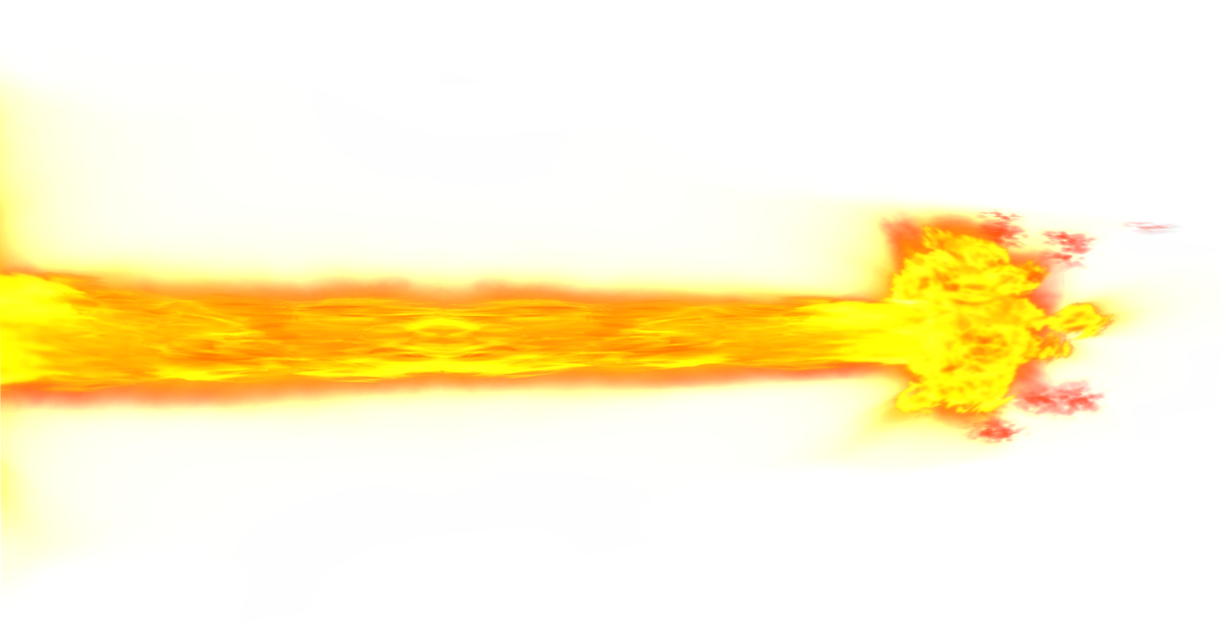

Our Father who established Yahusha in the heavens, Exalted is your name. Your Kingdom come. Your will be done in earth, as in the heavens. Give us this day our daily bread. And forgive us our transgressions, as we forgive those who transgress against us. And lead us not into evil inclination, but deliver us from the outer darkness.
Matt 6:9b-13 (All Scriptures taken from Eth Cepher unless otherwise noted.)

Slide 4
Thank you, Yahuah, that You promise us that where two or three are gathered You are there in the midst (Matt 18:20). Please cleanse, strengthen, restore, heal, inspire, teach us; and guide our hearts and minds with your Word of Truth in this presentation this day.

Slide 5
“If any of you lacks wisdom, you should ask Yahuah, who gives generously to all without finding fault, and it will be given to you” (James 1:5 NIV). Please teach each of us the truths that You would have us learn today, for we know that “man shall not live by bread alone but by every word that proceeds out of the mouth of Yahuah”
(Matt 4:4).

Slide 6
Please allow this presentation to be delivered and recorded clearly and succinctly, without technical difficulty or errors. “For Yours is the Kingdom, and
the power, and the glory, forever” (Matt 6:13b).
We ask these things in Yahusha’s precious name.

Slide 7

SCRIPTURAL HERMENEUTICS
[a] Introduction to
Rightly Dividing the Word of Truth
[b] Introduction to the
Egypt’s Locust Plague of Exo 10

Slide 8


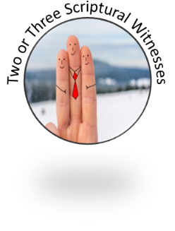
SCRIPTURAL HERMENEUTICS
Let’s examine our “hermeneutical hygiene” to ensure we are using
the correct lens to understand Scripture.
Hermeneutics is simply the approach and guidelines used to interpret
a text.

Slide 9
SCRIPTURAL HERMENEUTICS
First Mention Principle
  The first occurrence is like
  a backbone establishing
  the inherent meaning in
  a pattern throughout the
  rest of Scripture.
9

Slide 10

SCRIPTURAL HERMENEUTICS
2. Grammatical Interpretation
  Meaning the use of Grammatical Context/Content, Etymology, Usage, the function of words (Parts of Speech),
  the form of words (morphology), and
  the relationships of words (syntax/rules).

Slide 11

SCRIPTURAL HERMENEUTICS
Historical and Cultural Context
Make sure all definitions are based first in the Hebrew – choosing the correct definition
for the content/context.
Then compare other
lexicons, study aids and
commentators carefully.

Slide 12

SCRIPTURAL HERMENEUTICS
Forward Progressive Movement
Especially for any calendar studies, the events have to stay in order always moving forward.

Slide 13

SCRIPTURAL HERMENEUTICS
5. Layers of Scripture for Calendar Study: <Acronym: PaRaDiSe>
  P`shat: The actual literal meaning to be understood first. A “day”
  is one Light Season or one literal 24 hour cycle depending on the content & context. A day is not understood as “one year”(or 2 Pet 3:8).
  Remez: In calendar studies, where there is prophetic “symbolic” time, the “day” must be interpreted into the hermeneutic of
  “one literal day = one literal year” to understand the timeline
  on the secular historical level of the past timeframe.
  eg: Dan 7:25 has a timeline relating to 1260 days.
  In history this relates to the 1260 years from 538 – 1798 AD.
  Drash: Scriptural patterns abound and repeat often. eg: This means the prophecies of Daniel that relate to the prophetic meaning and have explanation in the past, help us to understand how the prophecies unfold. However, the patterns in those prophecies repeat in the endtime generation.
  In that case the timelines must be understood as “one literal day equals one literal day,” and not “one literal year.”
  Sod: A study on Gematria – based on the Hebrew meanings of “numbers.” eg: the 8th day can have linkage to “new beginnings.”
PaRaDiSe
P’shat
Remez
Drash
Sod
13
Notes:
Definition of quadriga : a chariot drawn by four horses abreast

Slide 14

Promises of the Word
The fear of YAHUAH is the beginning of wisdom: and the knowledge of the holy is understanding. Prov 9:10
I love them that love me; and those that seek me early shall find me.
Prov 8:17
And ye shall seek me, and find me, when ye shall search for me
with all your heart. Jer 29:13
If any of you lack wisdom, let him ask of YAH, that gives to all men liberally,
and upbraids [to defame/chide/taunt] not; and it shall be given him.
James 1:5
14

Slide 15
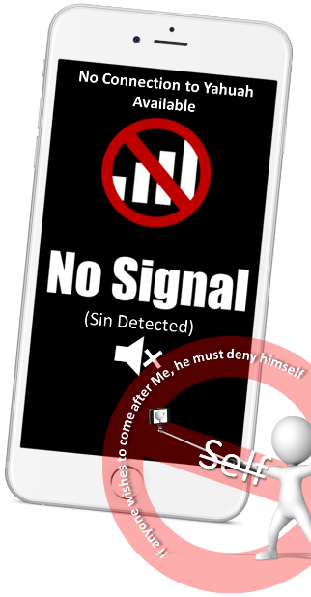

Recognizing Barriers to Understanding Yahuah’s Word
Stress from the death of a spouse, parent or child (Stress of death and mourning closely connected.)
Stress of strained marital relationship or dating relationship. (divorce/break-up/etc.)
Stress of financial issues.
Stress of injury (pain), chronic illness or poor health.
Stress from dismissal from work (unemployment).
Stress of being too busy with the cares of this world.
Stress of unhealthy addictions.
Stress of imprisonment/legal issues/victim of crime.
Stress of retirement.
Stress of persistent Relationship Problems, non-primary (difficulties with other family members, conflict and loss of friends, difficulties with coworkers).
Another Barrier: Even a good stress like winning the Lottery!

Slide 16
Promises of the Word
Study to show yourself approved
unto YAH, a workman that needs not to be ashamed, rightly dividing the
Word of Truth. 2 Timothy 2:15
Ask, and it shall be
given you;
seek, and ye shall find;
knock, and
it shall be opened
unto you:
for everyone
that asks receives;
and he that seeks finds; and to him that knocks
it shall be opened.
Matt 7:7-8
Yea, if you cry after knowledge, and lift up your voice for understanding;
If you seek her as silver, and
search for her as for hid treasures;
Then shall you understand
the fear of YAHUAH, and find
the knowledge of ELOHIM.
For YAHUAH gives wisdom:
out of his mouth comes knowledge
and understanding. Prov 2:3-6
16

Slide 17

Cognitive Dissonance:
psychological conflict resulting from incompatible beliefs and attitudes held simultaneously [double-mindedness]
When something simply doesn’t fit into your existing worldview or belief system, this
may cause mental and/or physical pain.
So, some choices must be made.
One must either reject the new conflicting information or modify the existing belief system to align with the new information.

Slide 18
Cognitive Dissonance:
psychological conflict resulting from incompatible beliefs and attitudes held simultaneously [double-mindedness]
Maintaining resistance to facts that expose
the fallacies of beliefs may cause discomfort.
It may even feel like a betrayal (as felt in a dating/marriage relationship).
Remember: “For our struggle is not against flesh and blood, but against the rulers, against the authorities, against the powers of this world’s darkness, and against the spiritual forces of evil in the heavenly realms.” Eph 6:12

Slide 19




NAVIGATING CALENDAR THEORIES
Critically evaluating new information requires that
the person be able to exercise their sense of reason and logic.
Critical thinking is often synonymous to active learning.
Active learning is in contrast
to passive learning in that it requires the person to exercise their sense of skepticism and doubt, rather than taking in
any theory or idea with unquestionable acceptance!
It also requires one to
invest time in study.
The Word of Truth should be the guide,
NOT tradition or feelings.
Question everything!

Slide 20
NAVIGATING CALENDAR THEORIES
Through critical evaluation, each person must test the various facets of the topic or idea to see that it makes logical sense.
Find the courage to face
that much of what you
believe may be incorrect.
Conduct your own research.
“Study to shew thyself approved unto Yahuah, a workman that needeth not to be ashamed, rightly dividing the word of truth.” (2 Tim 2:15)
The Word of Truth should be the guide,
NOT tradition or feelings.
Question everything!

Slide 21
Five Questions
for thought:
1. Are there any idle words in Scripture that have no meaning, or importance, except to simply fill space?
(eg: genealogies?)
Think Tank
21

Slide 22
Questions
for thought:
2. Through the testimony of the
“locust infestation,” what PATTERN will Scripture unfold to document the accurate timing of this event? (Sunset Theory or Dawn?)
Think Tank

Slide 23
Questions
for thought:
3. Why doesn’t Scripture leave out the Exodus 10 timing details and just say:
“Moses brought the locusts to Egypt?”
Think Tank

Slide 24
Questions
for thought:
Again:
Will Exodus 10 support Sunset or Dawn?
4. Will the timing details of this event begin to diminish the controversy as to when the day begins, according
to Scripture?
Think Tank

Slide 25
Questions
for thought:
5. There is PLENTY of EVIDENCE exposing the counterfeit change of when the day begins
(from Jewish rabbinical history; non-secular recorded history; Catholic history).
Can Exodus 10 expose the truth of the matter and stand as another witness?
(Please see the study that offers the historical evidence.)
Think Tank

Slide 26
NAVIGATING CALENDAR THEORIES
The Word of Truth should be the guide,
NOT tradition or feelings.
We are now ready to put everything together!

Slide 27









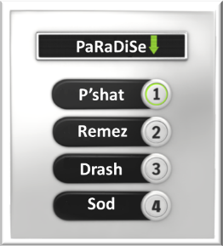
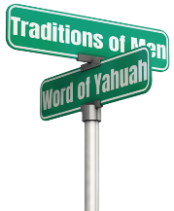









How to STUDY Infographic
Yahuah does NOT repeat things of no great consequence (Gen 41:32). Pay attention to repeated items, times, days, and things that
make you go “hmmm”.
These are HINTS.
Renew Your Mind
Grammar Police:
Examine the Scripture closely.
Be Filled with the Holy Spirit
3
5
Do not be conformed to this world; but be transformed by the renewing of your mind. Then you will be able to test and approve what is the good, pleasing, and perfect will of Yahuah (Rom 12:2).
.
Torah First. Covenant Torah for calendar study.
1
Dig Deeper. It is the glory of Yah to
conceal a thing:
but the honour of kings is to search
out a matter.
Prov 25:2
4
Forward Progressive Movement
Scriptural
Witnesses
CAUTION: Itching ears, traditions of men, and snares. Get discernment and DO NOT BE DECIEVED.
6
7
Need at least
2-3 witnesses: more is always better.
Examine your hermeneutical hygiene and use all the Bible tools that are available!
2
2 Tim4:3,Col2:8,Deut 12:30,
Rom 16:17-18,2Thess2:10-11

Slide 28
How to STUDY Infographic
Yahuah does NOT repeat things of no great consequence. Gen 41:32 Pay attention to repeated items, times, days, and things that
make you go “hmmm”.
These are HINTS.
Renew Your Mind
These general rules & principles are important for any Scriptural study, especially calendar!
Grammar Police:
Examine the Scripture closely.
Be Filled with the Holy Spirit
3
5
Do not be conformed to this world; but be transformed by the renewing of your mind. Then you will be able to test and approve what is the good, pleasing, and perfect will of Yahuah. Rom 12:2
.
Torah First. Covenant Torah for calendar study.
1
Dig Deeper. It is the glory of Yah to
conceal a thing:
but the honour of kings is to search out a matter.
Prov 25:2
4
Forward Progressive Movement
Scriptural
Witnesses
CAUTION: Itching ears, traditions of men, and snares. Get discernment and DO NOT BE DECIEVED.
6
7
Need at least
2-3 witnesses: more is always better.
Examine your hermeneutical hygiene and use all the Bible tools that are available!
2
2 Tim4:3,Col2:8,Deut 12:30,
Rom 16:17-18,2Thess2:10-11

Slide 29
Thought to Ponder:
Exodus 10 is a study focusing on Yahuah’s
calendar day-start.
Before we launch into the introduction for the locust details, let’s take note of some counsel from Job, Isaiah, King Solomon and Jeremiah.
Think Tank

Slide 30
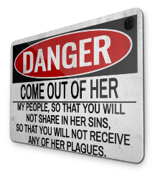




The book of Job is considered one of the earliest writings in the Scriptures.
Let’s read Job 17:8-12 to find out if Job had an opinion on this topic.
Is there any hint in Job’s words that he would mix Yahuah’s instructions with the traditions of men?

Slide 31
Job 17
8 Upright men shall be astonied at this, and the innocent shall stir up himself against the hypocrite.
9 The righteous also shall hold on his way, and he that
has clean hands shall be stronger and stronger.
10 But as for you all, do ye return, and come now:
for I cannot find one wise man among you.
11 My days are past, my purposes are broken off,
even the thoughts of my heart.
Verse 12 They change the night into day:
the light is short because of darkness.

Slide 32
Isaiah 5
20 Woe unto them that call evil good, and good evil;
that put darkness for light,
and light for darkness;
that put bitter for sweet,
and sweet for bitter!

Slide 33
A Closer Look: Did you notice:
1. Job & Isaiah speak of hypocritical
people changing the night into day.
33

Slide 34
Ecclesiastes 1
9 The thing that has been, it is that which shall be;
and that which is done is that which shall be done:
and there is no new thing under the sun.
(What is Solomon talking about in Eccl 1:9?)

Slide 35
A Closer Look: Did you notice:
1. Job & Isaiah speak of hypocritical people changing
the night into day.
2. In Ecclesiastes, Solomon declares
that all things under the sun have
already been. (Truth & error?)

Slide 36
A Closer Look: Did you notice:
1. Job & Isaiah speak of hypocritical people changing
the night into day.
2. In Ecclesiastes, Solomon declares that all things under the sun have already been. (Truth & error?)
3. No man can physically manipulate the length of a day; only Yahusha can do this. (Note: every detail about His worship days are part of His everlasting covenant.)
What will Jeremiah have to tell us?

Slide 37


Jeremiah 33
20 Thus says YAHUAH; If ye can break my covenant of the day, and my covenant of the night, and that there should not be day and night in their season;
21 Then may also my covenant be broken with David my servant, that he should not have a son to reign upon his throne; and with the Levites, the priests, my ministers.
25 Thus says YAHUAH; If my covenant be not with day and night, and if I have not appointed the
ordinances of heaven and earth;
26 Then will I cast away the seed of Jacob and David my servant, so that I will not take any of his seed to be rulers over the seed of Abraham, Isaac, and Jacob: for I will cause their captivity to return, and have mercy on them.
Yahuah guarantees the surety of His “covenant”
by referring to the surety of natural law as proof of the surety of His promises.
Did we ever stop to think about how important
“day” and “night” are in comparison to Yahuah’s promises?
And have you noticed,
the “day” is mentioned before the “night” in
these passages?
Question: What are Job and
Jeremiah referring to?
37

Slide 38
A Closer Look: Did you notice:
1. Job & Isaiah speak of hypocritical people
changing the night into day.
2. In Ecclesiastes, Solomon declares that all things under the sun have already been. (Truth & error?)
3. We know that a man cannot physically manipulate the length of a day; only Yahusha can do this.
(Note: every detail about His worship days are part
of His everlasting covenant.
See the verses from Jeremiah on the next slide.)
4. Can man manipulate the borders that determine when day cycles begin and end?

Slide 39

More Counsel
from Jeremiah
Jer 31:35-36 Thus saith Yahuah, which giveth the sun for a light by day,
and the ordinances of the moon and of the stars for a light by night,
which divideth the sea when the waves thereof roar …
36 If those ordinances depart from before me, saith Yahuah, then the
seed of Israel also shall cease from being a nation before me for ever. (KJV)
Again, Yahuah refers to the surety and permanence of natural law and order as a guarantee of the surety and permanence of the “everlasting covenant.”
39

Slide 40



Question:
What are Job and Jeremiah referring to?
When Preparation NIGHT Season (or Friday NIGHT in pagan terms) is declared as qodesh [Holy] 7th Day Sabbath hours (because Sunset Theory begins the Sabbath on the Preparation NIGHT Season at SUNSET) …
Does that mean … that
Friday NIGHT is also considered PART of the DAY
hours of the Sabbath?

Slide 41







More Questions to consider:
Is it possible Job was shown a compromise with paganism?
Is there anywhere in Scripture where we are reminded, admonished, commanded, urged or compelled to contemplate
upon the 7th Day Sabbath NIGHT Season, before the Day Season?
How does this connect with Locusts?
If the account of the “locust infestation” found in
Exodus 10 supports DAWN as the beginning of each Scriptural day… thus eliminating the Sunset Theory application from Exodus 10; then this “rambling on”
about Job’s declaration will be justified!

Slide 42
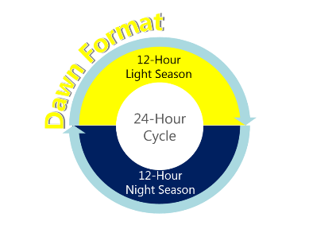
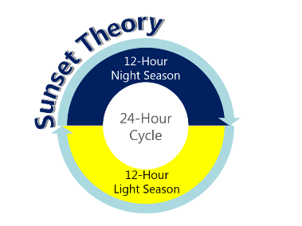
It is time to examine the following diagrams for serious consideration.
Hermeneutic principles can
help us understand the concepts of Covenant Calendar in an organized manner – especially for every single day-start.
This illustration presents two options for the “beginning”
of a 24 Hour cycle
of time:
Dawn Format
Sunset Theory
(locusts or no locusts)!
Which one is correct?
By the end of a complete search in Exodus 10,
(including many more calendar studies for the Scriptural Day-start),
only ONE of the two options will align with Scripture.

Slide 43


Important clarification of terms you will encounter in
this and other studies on this topic are …
#1: <`owr> Light H216 (Strong’s)
Illumination, bright, clear, day, light, morning.
12 Hour Light Season
0
R
’
W

Slide 44

#2: <layil> Night H3915 (Strong’s)
A twist away of light.
12 Hour Night Season
L
L
I
A
Y

Slide 45



One Cycle = the two time segments in one 24 Hour Dual Season
Day Season: 12 Hour Time Segment
Night Season: 12 Hour Time Segment
Strong’s H216
Light
‘Owr:
Illumination or (concretely) luminary (in every sense, including lightning, happiness, etc.): KJV - bright, clear, + day, light (-ning), morning, sun.
Total KJV occurrences: 122
Strong’s H3915
Night
Layil:
From the same as H3883; properly a twist (away of the light), that is, night; figuratively adversity: KJV - ([mid-]) night (season).
Total KJV occurrences: 233
12-Hour Light Season
12-Hour Night Season
24 Hour Cycle
This Photo by Unknown Author is licensed under CC BY-SA-NC
Dual
Season
Genesis 1:3-5

Slide 46
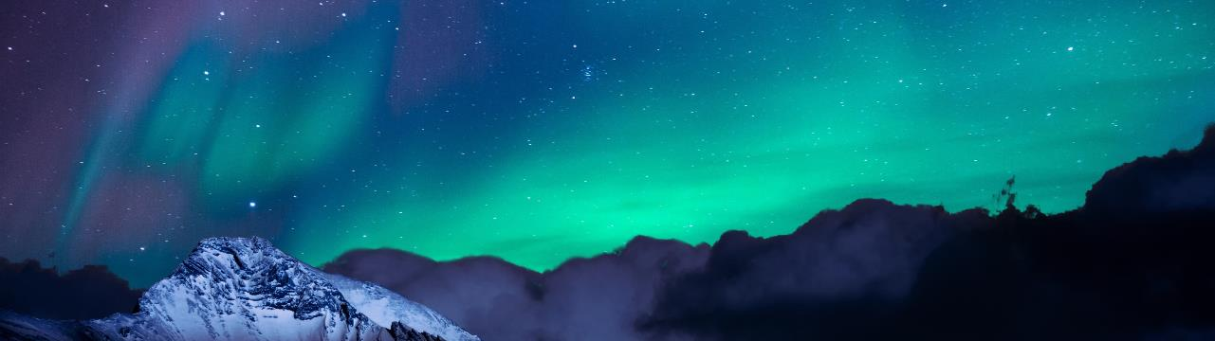

1. Sunset Theory
Before we look at the Sunset Theory Chart
in the Locust study, examine the following simple diagrams.
Remember,
they present
two options
for a 24 Hour
Cycle of Time.
12 Hour Night Season
12 Hour Light Season
12 Hour Night Season
Believed by most Mainstream
Sabbath-keeping Christianity
as well as Jewish Tradition.
Sunset to Sunset 24 Hour Cycle
2. Dawn Format
12 Hour Light Season
12 Hour Night Season
12 Hour Light Season
Dawn to Dawn 24 Hour Cycle
Supported by the Locusts
of Exodus 10???

Slide 47
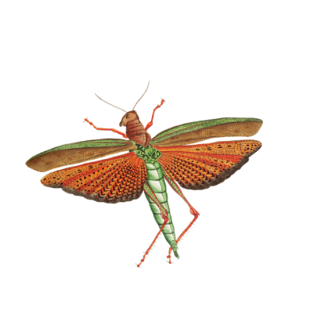

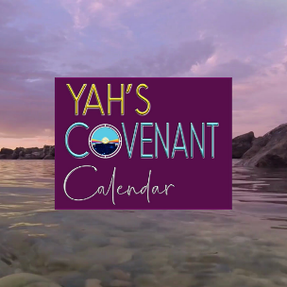




In preparation for Part 2
let’s read Exodus 10:1-14
remembering the
words of the
prophets!
Myriads of Ravaging Locusts

Slide 48

Exodus 10
1 And Yahuah said unto Moses, Go in unto Pharaoh: for I have hardened his heart, and the heart of his servants, that I might shew these my signs before him:

Slide 49

Exodus 10
2 And that thou mayest tell in the ears of thy son, and of thy son's son, what things
I have wrought in Egypt, and my signs which I have done among them; that ye may know how that I am Elohim.
49

Slide 50

Exodus 10
And Moses and Aaron came in
unto Pharaoh, and said unto him,
Thus saith Yahuah Elohim of the Hebrews, How long wilt thou refuse
to humble thyself before me?
let my people go, that they may serve me.
50

Slide 51

Exodus 10
4 Else, if thou refuse to
let my people go, behold,
to morrow will I bring the locusts into thy coast:

Slide 52

2 And that thou mayest tell in the ears of thy son, and of thy son's son, what things I have wrought in Egypt, and my signs which I have done among them; that ye may know how that I am the LORD.
3 And Moses and Aaron came in unto Pharaoh, and said unto him, Thus saith the LORD God of the Hebrews, How long wilt thou refuse to humble thyself before me? let my people go, that they may serve me.
4 Else, if thou refuse to let my people go, behold, to morrow will I bring the locusts into thy coast:
5 And they shall cover the face of the earth, that one cannot be able to see the earth: and they shall eat the residue of that which is escaped, which remaineth unto you from the hail, and shall eat every tree which groweth for you out of the field:
6 And they shall fill thy houses, and the houses of all thy servants, and the houses of all the Egyptians; which neither thy fathers, nor thy fathers' fathers have seen, since the day that they were upon the earth unto this day. And he turned himself, and went out from Pharaoh.
7 And Pharaoh's servants said unto him, How long shall this man be a snare unto us? let the men go, that they may serve the LORD their God: knowest thou not yet that Egypt is destroyed?
8 And Moses and Aaron were brought again unto Pharaoh: and he said unto them, Go, serve the LORD your God: but who are they that shall go?
9 And Moses said, We will go with our young and with our old, with our sons and with our daughters, with our flocks and with our herds will we go; for we must hold a feast unto the LORD.
10 And he said unto them, Let the LORD be so with you, as I will let you go, and your little ones: look to it; for evil is before you.
11 Not so: go now ye that are men, and serve the LORD; for that ye did desire. And they were driven out from Pharaoh's presence.
12 And the LORD said unto Moses, Stretch out thine hand over the land of Egypt for the locusts, that they may come up upon the land of Egypt, and eat every herb of the land, even all that the hail hath left.
13 And Moses stretched forth his rod over the land of Egypt, and the LORD brought an east wind upon the land all that day, and all that night; and when it was morning, the east wind brought the locusts.
14 And the locusts went up over all the land of Egypt, and rested in all the coasts of Egypt: very grievous were they; before them there were no such locusts as they, neither after them shall be such.
KJV
Exodus 10
5 And they shall cover the face of the earth, that one cannot be able to see the earth: and they shall eat the residue of that which is escaped, which remaineth unto you from the hail, and shall eat every tree which groweth for you out of the field:

Slide 53
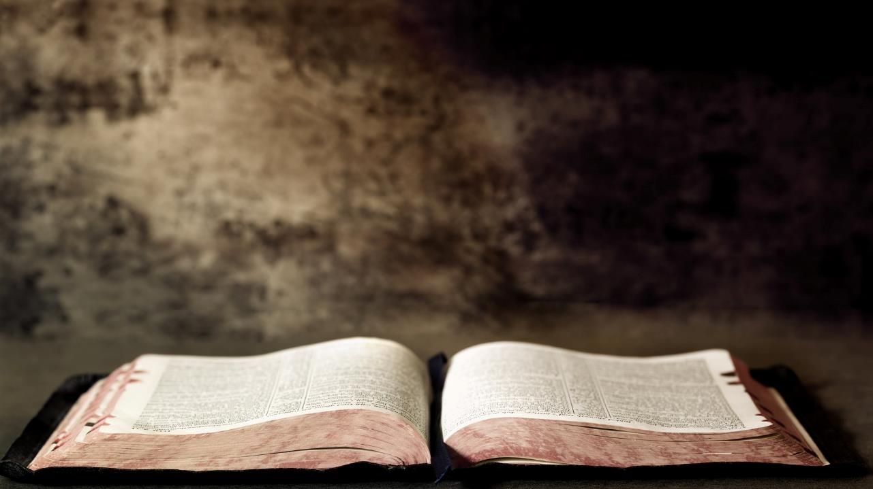
Exodus 10
6 And they shall fill thy houses, and the houses of all thy servants, and the houses of all the Egyptians; which neither thy fathers, nor thy fathers' fathers have seen, since the day that they were upon the earth unto this day. And he turned himself, and went out from Pharaoh.

Slide 54

Exodus 10
7 And Pharaoh's servants said unto him, How long shall this man be a snare unto us?
let the men go, that they may serve Yahuah their Elohim: knowest thou not yet that Egypt is destroyed?

Slide 55

Exodus 10
8 And Moses and Aaron were brought again unto Pharaoh: and he said unto them, Go, serve Yahuah your Elohim: but who are they that shall go?

Slide 56

9 And Moses said, We will go with our young and with our old, with our sons and with our daughters, with our flocks and with our herds will we go; for we must hold a feast unto Yahuah.
Exodus 10
56

Slide 57

Exodus 10
10 And he said unto them, Let Yahuah be so with you,
as I will let you go, and your little ones: look to it; for evil
is before you.
57

Slide 58

Exodus 10
11 Not so: go now ye that are men,
and serve Yahuah; for that ye did desire.
And they were driven out from Pharaoh's presence.

Slide 59
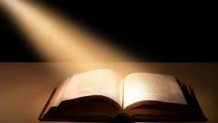
12 And Yahuah said unto Moses, Stretch out thine hand over the land of Egypt for the locusts, that they may come up upon the land of Egypt, and eat every herb of
the land, even all that the hail hath left.
(Notice what happens next!)
Exodus 10

Slide 60

13 And Moses stretched forth his rod over the land of Egypt, and Yahuah brought an east wind upon the land all that day, and
all that night; and when it was morning,
the east wind brought the locusts.
Exodus 10

Slide 61

Exodus 10
14 And the locusts went up over all the land of Egypt, and rested in all the
coasts of Egypt: very grievous were they;
before them there were no such locusts
as they, neither after them shall be such.

Slide 62
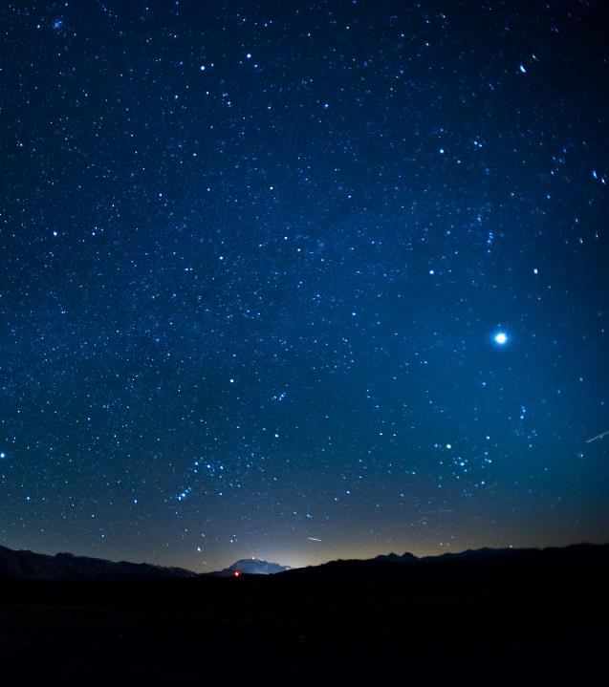




With a simple reading of Exodus 10:1-14 can the day-start be discerned?
Question: In Part 2 will the Locust Plague of Egypt declare the answer?
Sunset Theory
Dawn Format
12-Hour
Night Season
12-Hour
Light Season
24-Hour
Cycle
24-Hour
Cycle
12-Hour
Light Season
12-Hour
Night Season
#1 Is Sunset day-start correct?
#2 Or … is Dawn day-start correct?

Slide 63
Promises of the Word
It is the glory of ELOHIM to
conceal a thing: but the honour
of kings is to search out a matter.
Prov 25:2
Call unto me, and
I will answer you, and show you great and mighty things, which you know not.
Jer 33:3
Now the secrets of YAHUAH our ELOHIM, and the revealing to us and our sons forever, is by the keeping of all the words of this Torah.
Deut 29:29

Slide 64



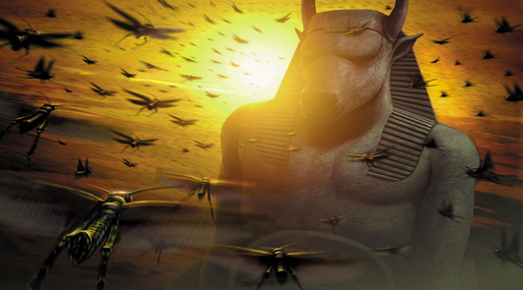
In Part 2 there will be a thorough investigation of the Plague.
What do the Locusts know?
8th
The End
of Part 1
Exodus 10:4, 5, 12, & 13

Slide 65


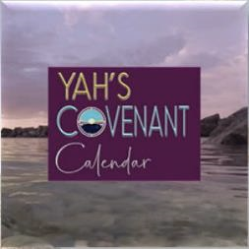



questions@studythecalendar.com www.studythecalendar.com/resources
OR www.covenantcalendar.club
Questions
If you need assistance with this information, please send your questions to Timothy Astleford or Charlene Fortsch.
65

